Slide 1
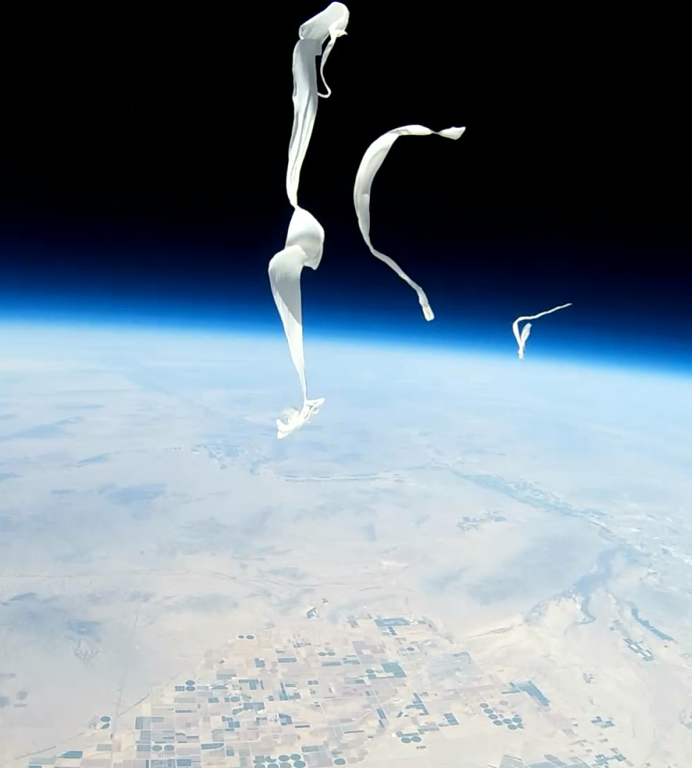
GCC ASCEND Team Spring 2021
Andrea Maya
Ricardo Ontiveros
Dylan Hutchins
Mentor: Dr. Tim Frank

Slide 2
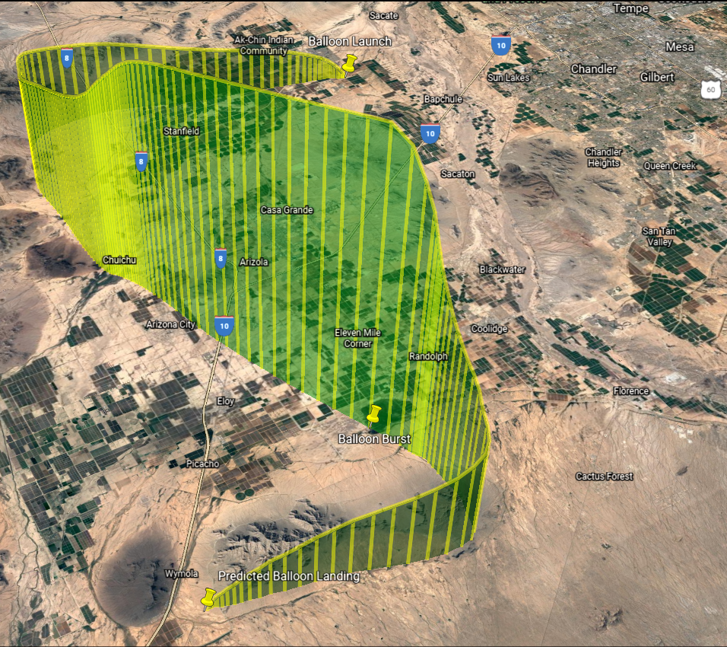
Our Team Objectives
Work socially distanced
Construct three payloads
Record video of the flight
Record & Analyze Data

Slide 3
Sensors & Components
Si7021 Humidity Sensor
Micro SD Card Reader
Runcam 2
UV blocking Lens
7.4 V Li-ion Battery
Arduino UNO
TMP 36
LIS3DH Accelerometer
ASDX Pressure Sensor

Slide 4
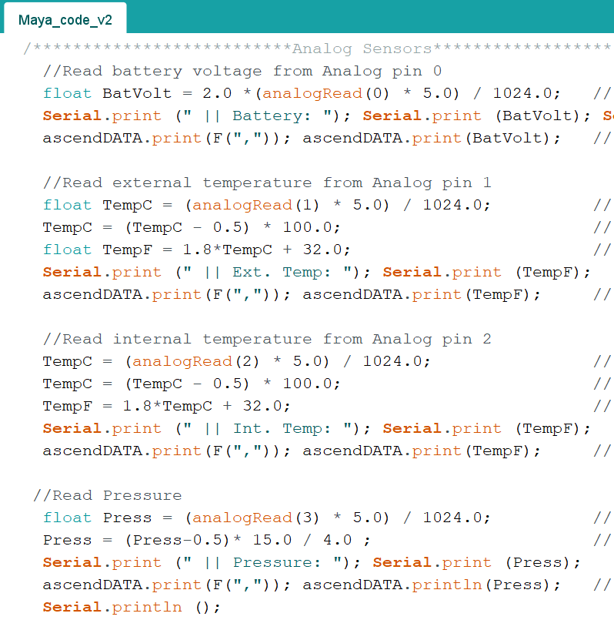
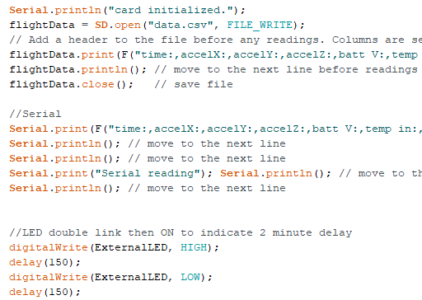
Software Overview
Arduino IDE

Slide 5
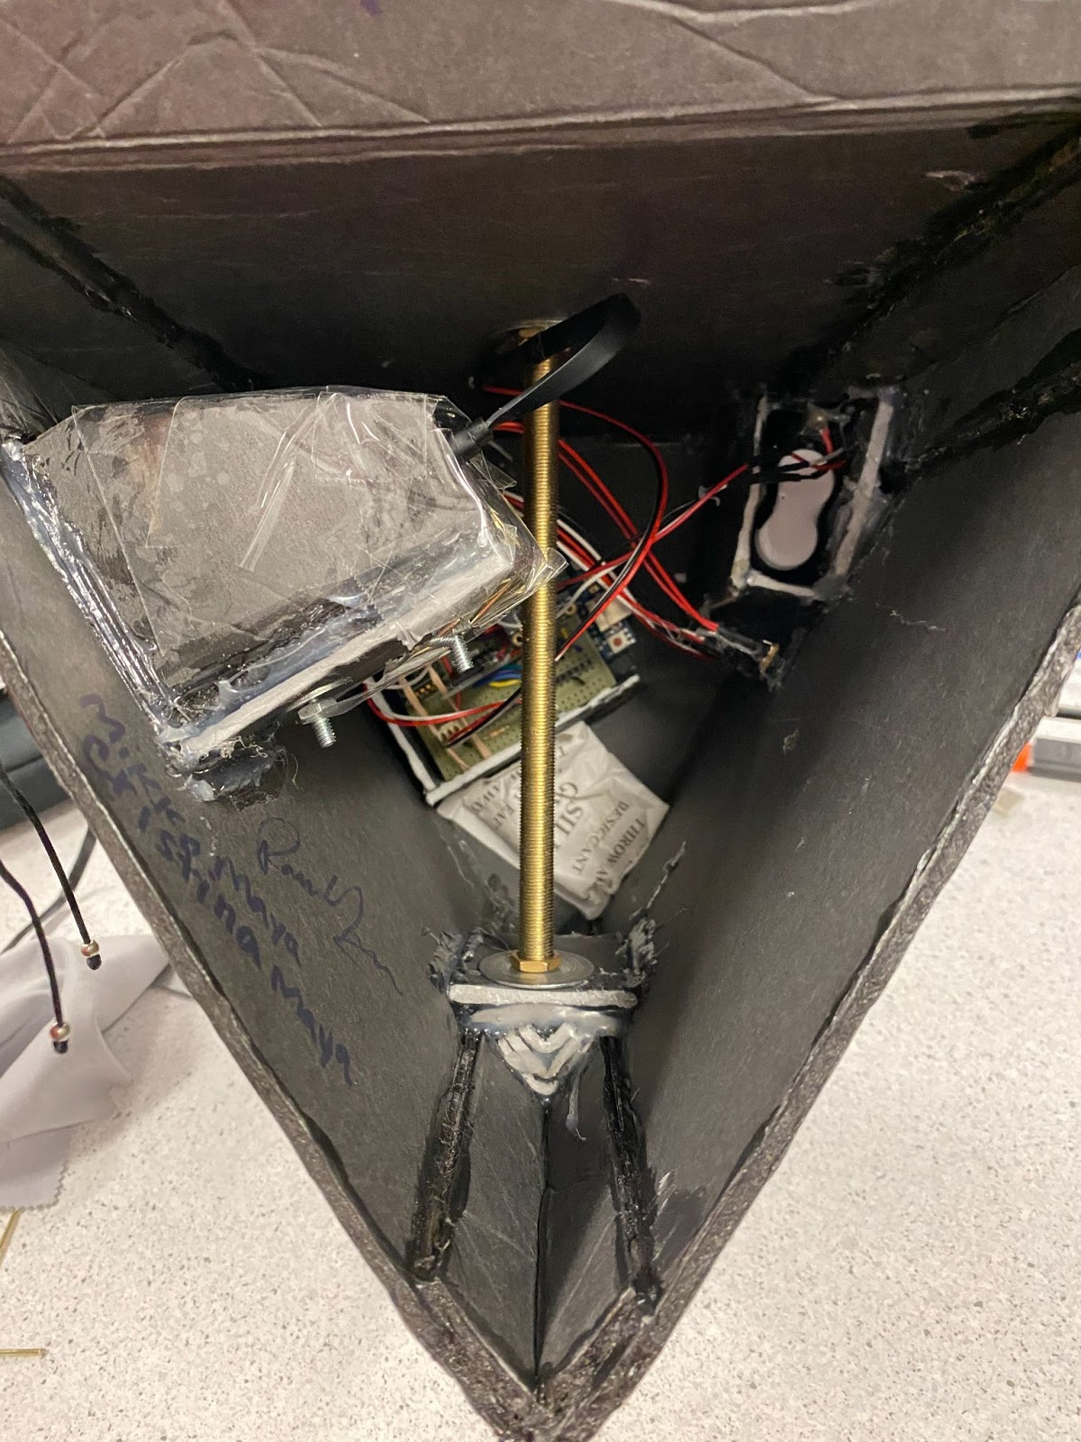
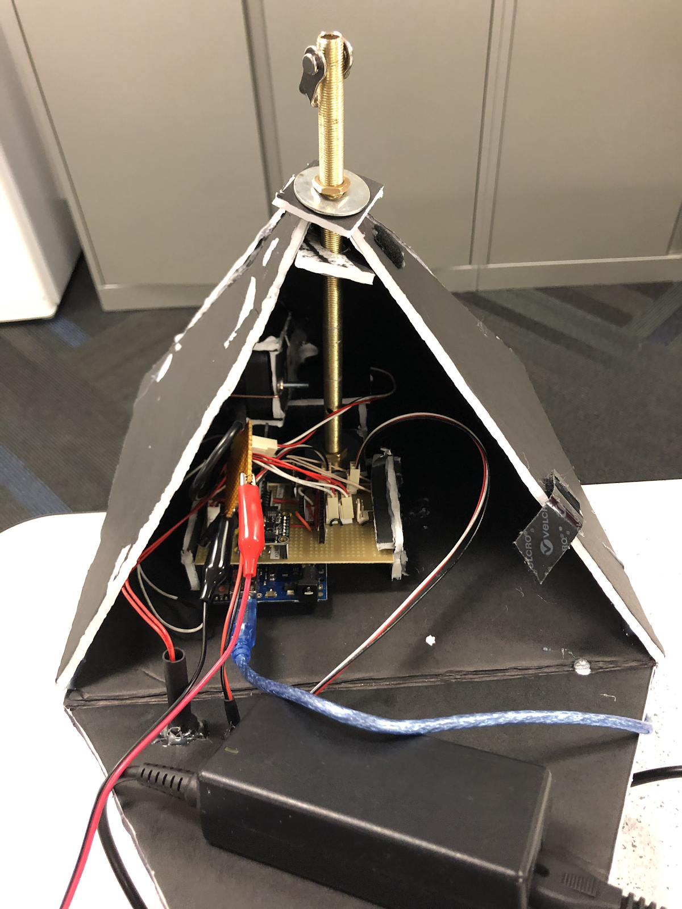
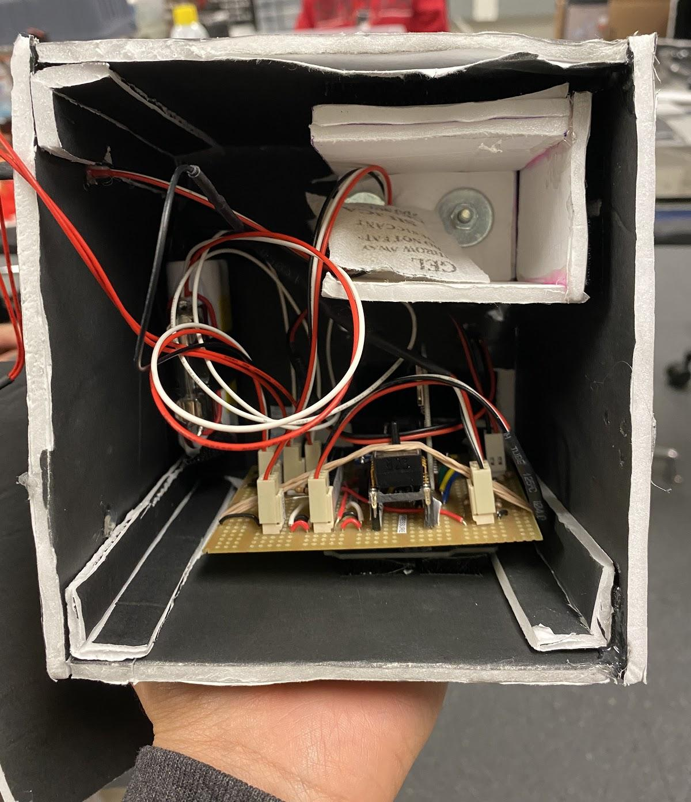
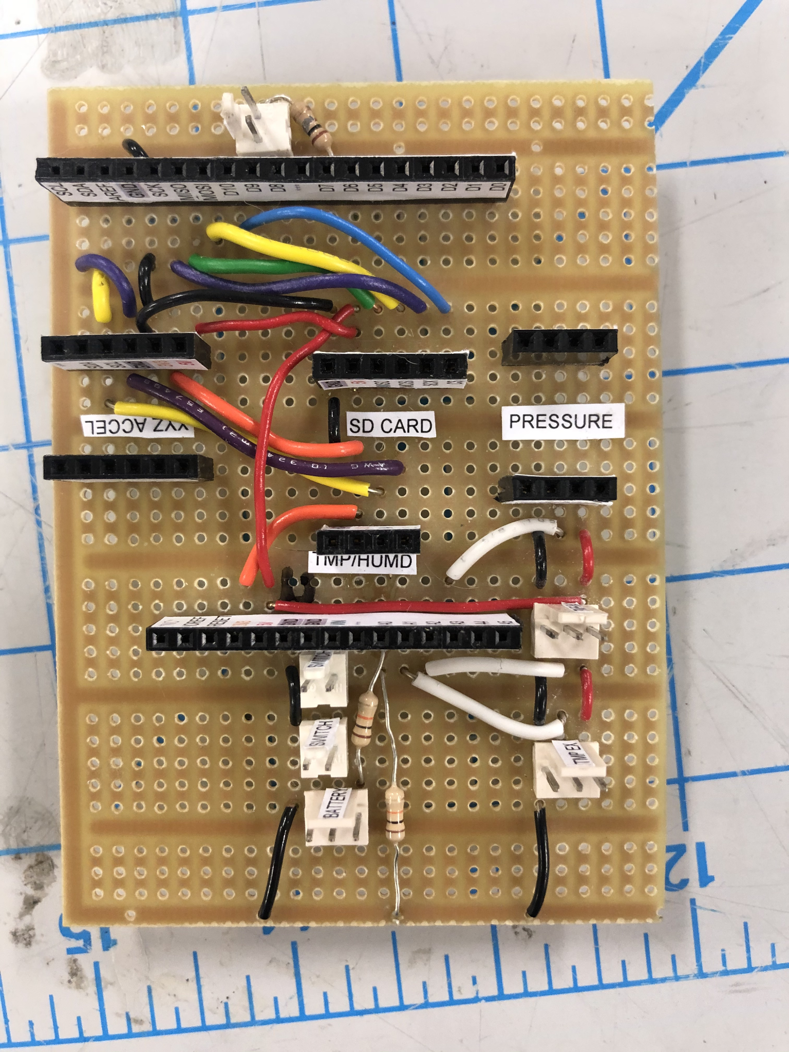
Payload Builds x3
Foamboard case
Soldered circuit board
UV protective lens
Lamp rod attachment

Slide 6
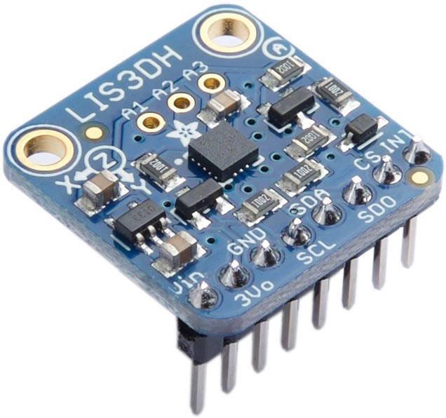
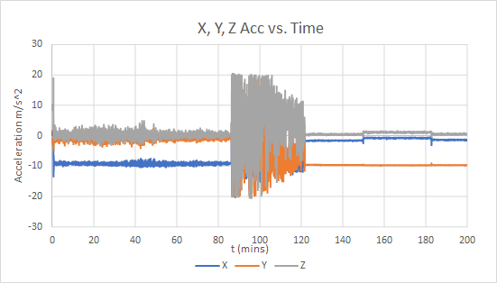
LIS3DH Accelerometer Data
Data:
Scaled to ± 2g
Burst:
86 mins
Descend:
Duration: 35 mins
Total time:
121 mins

Slide 7
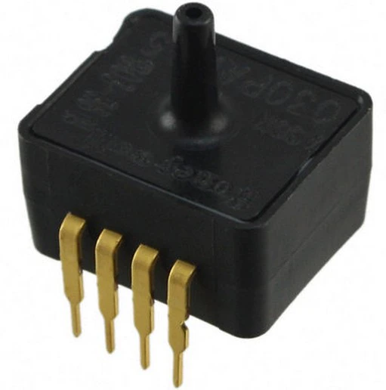
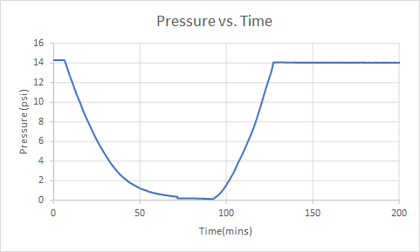
ASDX Pressure Sensor
Pressure in Phoenix area: 14.80 psi
At 86 mins balloon begins to fall and increase pressure
Lowest psi recorded: 0.14 psi

Slide 8
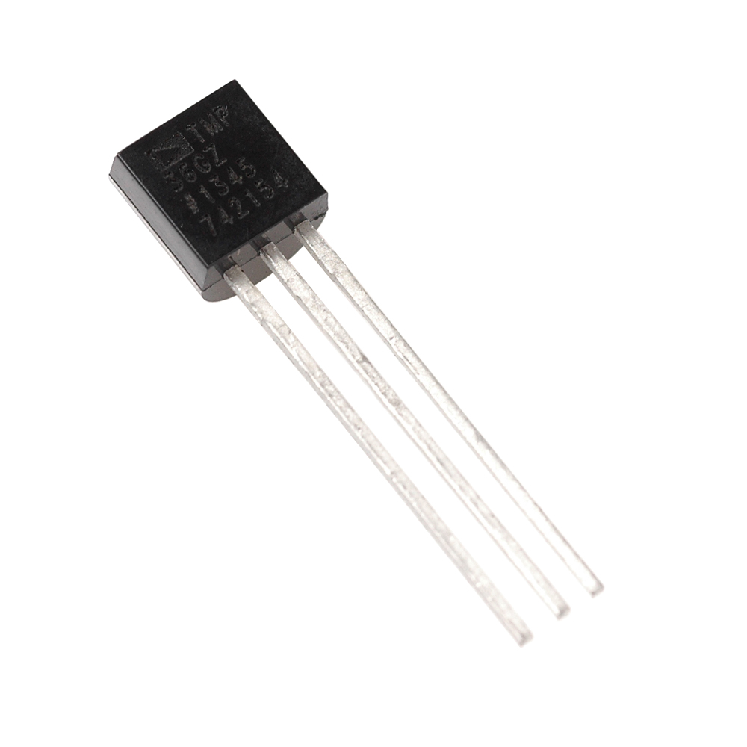
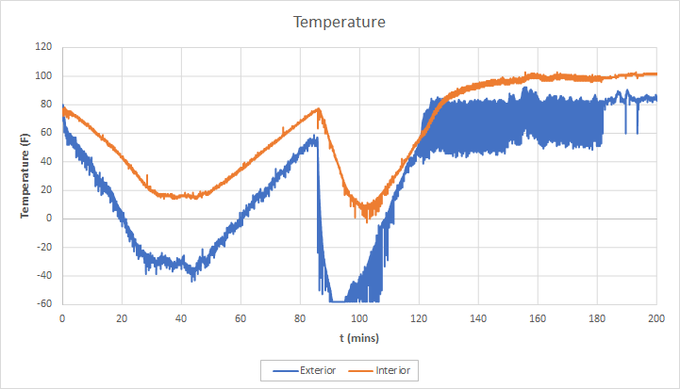
TMP36 Temperature Data
Temperature fluctuates through different atmosphere layers
Interior Temperature
Min:
Approximately 16 ℉ 104 - 107 mins during descent
Temperature at burst:
Approximately 77 ℉ Highest point in stratosphere
Exterior Temperature
Min during ascent:
Approximately -35 ℉
Around 42 - 47 mins
Min during descent:
Approximately -60 ℉
Around 90 - 96 mins

Slide 9
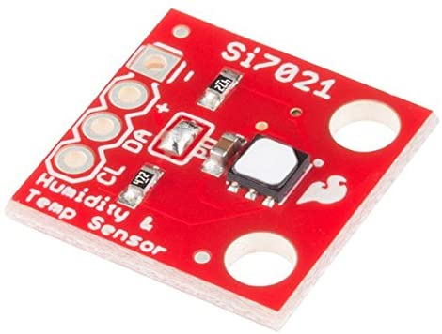
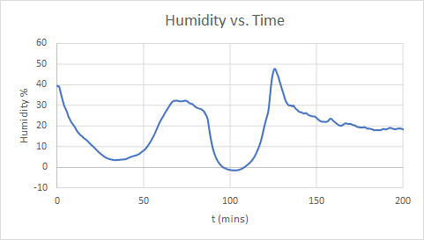
Humidity Data
Temperature matches humidity graph
Humidity rose and fell through different atmosphere layers
Silica gel retained moisture upon landing

Slide 10
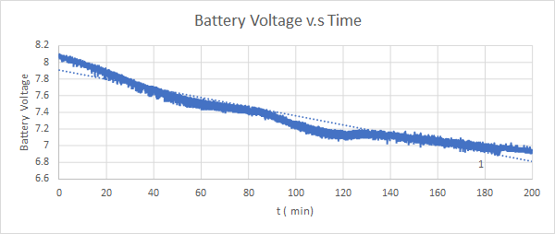
7.4 Li-Ion Battery
Fully charged Lithium Ion battery
Used to power all sensors + camera
Experienced linear decline
Lowest voltage: 6.94 V

Slide 11
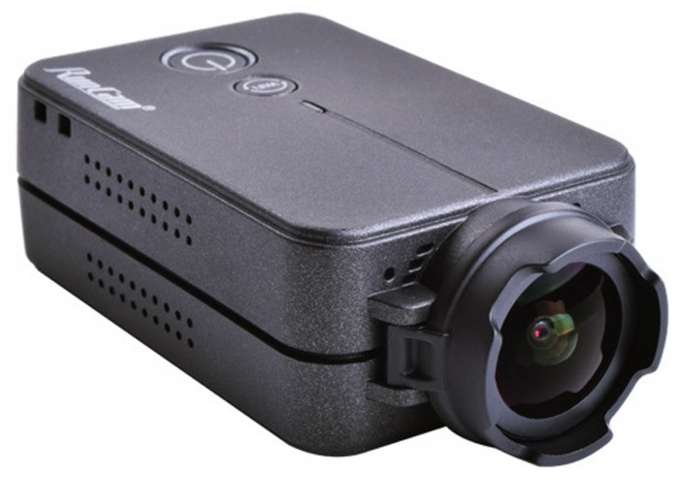
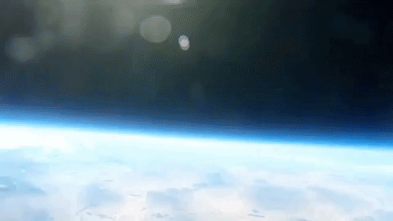
Runcam 2
Setup:
Connected and controlled by the Arduino Uno by USB cable. Held in place by clamps with on button pushed down
Records for 17 minutes per clip and saves onto SD card
Ascend time: 86 mins

Slide 12
Thank you for you time!
Special Thanks to:
GCC Engineering Club, Anyell Mata, Dr. Tim Frank, NASA, ANSR
Questions?

